Slide 1


Movie Recommendation System
Ameya Adwait Ranade 1561048
Manisha Bagora 2199292
Parul Vig 1356967
Neelam Dighe 2989348

Slide 2




Introduction
A Movie recommendation system is an ML-based approach to filtering or predicting the users' film preferences based on their past choices and behavior.

Slide 3

Problem Statement
Recommendation Systems have become very popular with the increasing availability of millions of products online such as movies, music, books etc. Movie recommendation System has been a surge in the usage of the users opting for online streaming services. MRS research continues to face significant obstacles even if today's MRSs significantly assist consumers in finding interesting Movie in these vast archives. Developing, implementing, and evaluating recommendation techniques that utilize knowledge beyond a basic metric and parameter to suggest a recommendation is challenging. In this project, we examine the different algorithm for overcoming these difficulties, then accordingly we come up with the recommendation system.

Slide 4
Data Set Description -Data Set
This dataset (ml-25m) describes 5-star rating and free-text tagging activity from [MovieLens] (http://movielens.org), a movie recommendation service.
It contains 25000095 ratings and 1093360 tag applications across 62423 movies. These data were created by 162541 users between January 09, 1995 and November 21, 2019.
This dataset was generated on November 21, 2019.Users were selected at random for inclusion. All selected users had rated at least 20 movies. No demographic information is included. Each user is represented by an id, and no other information is provided.
The data are contained in the files `genome-scores.csv`, `genome-tags.csv`, `links.csv`, `movies.csv`, `ratings.csv` and `tags.csv`. More details about the contents and use of all these files follows.

Slide 5
Approach
Once we read the data set, we first perform some data cleaning and preprocessing, like checking null values, merging files, creation of data frame, sorting, calculating average rating
After that we performed EDA to have a clear picture of it and understand the features within the dataset with visualizations
The filtered data frame is then transformed into a matrix of movie ratings by user, with movies as the rows and users as the columns. This matrix is then converted into a sparse matrix for more efficient computation. The k-NN model is then trained on this matrix using the cosine distance metric and the brute algorithm.
We have implemented algorithms like User Based Collaborative Filtering , Matrix Factorization, Logistic regression, Random Forecast Classifier & Item based collaborative filtering, Truncated SVD, SVD using hyper parameter tuning.

Slide 6
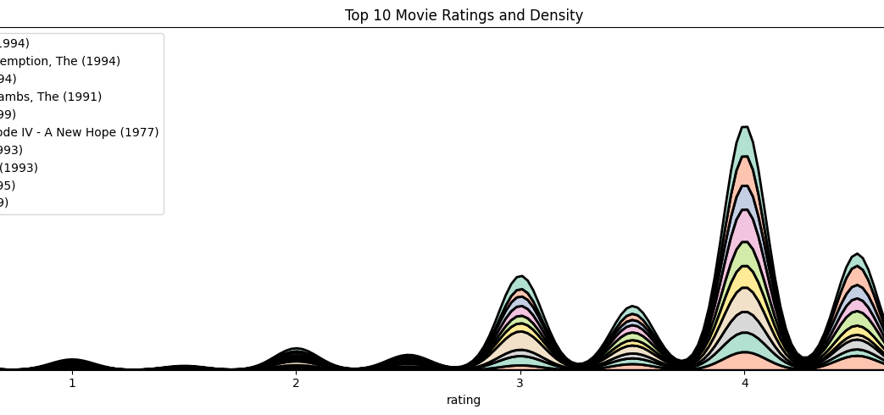
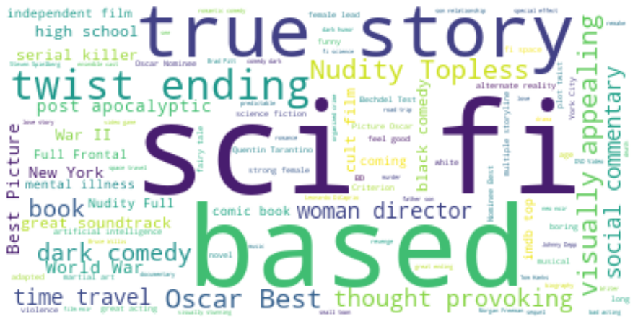
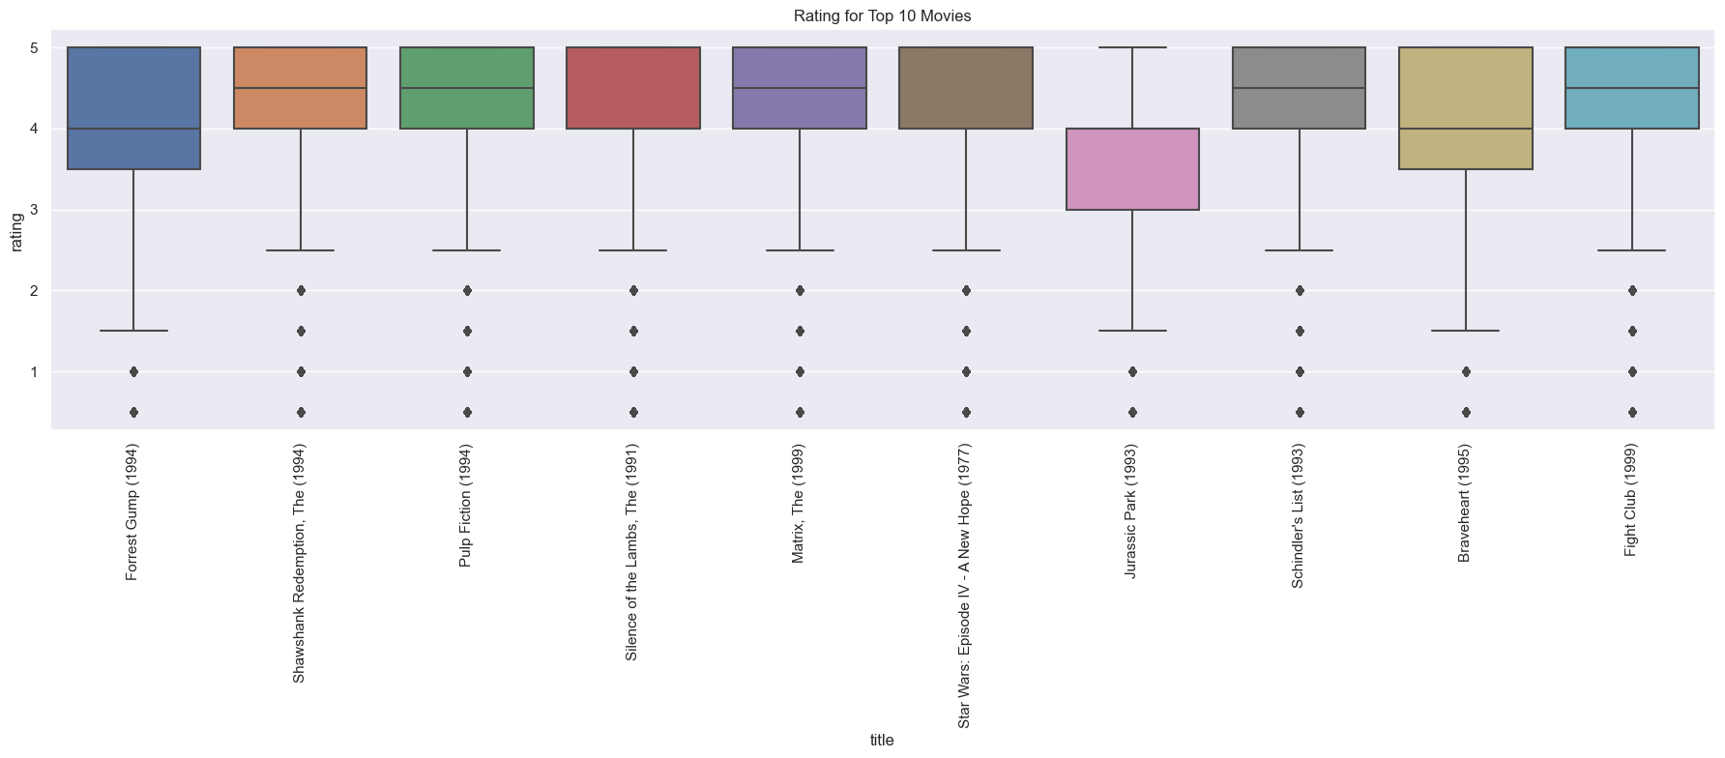
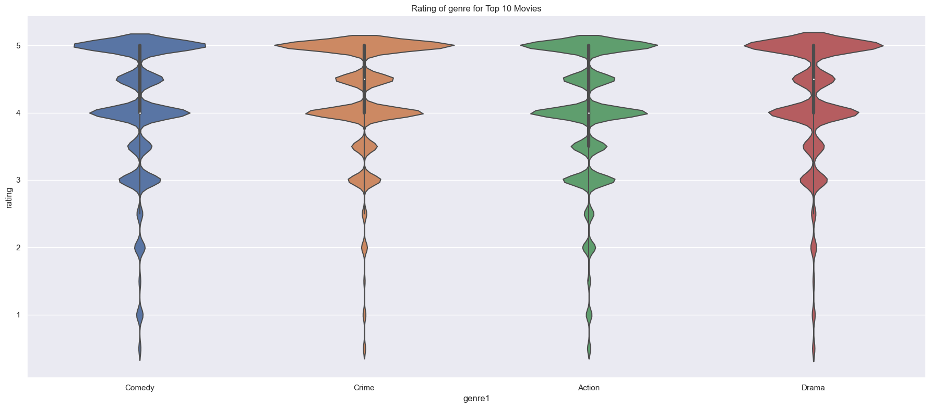
Visualization
KDE Plot -Top 10 Movie Rating
World Cloud- Based on Movie Tags
Box Plot- Top 10 Movie Rating
Violinplot- Genre Rating

Slide 7
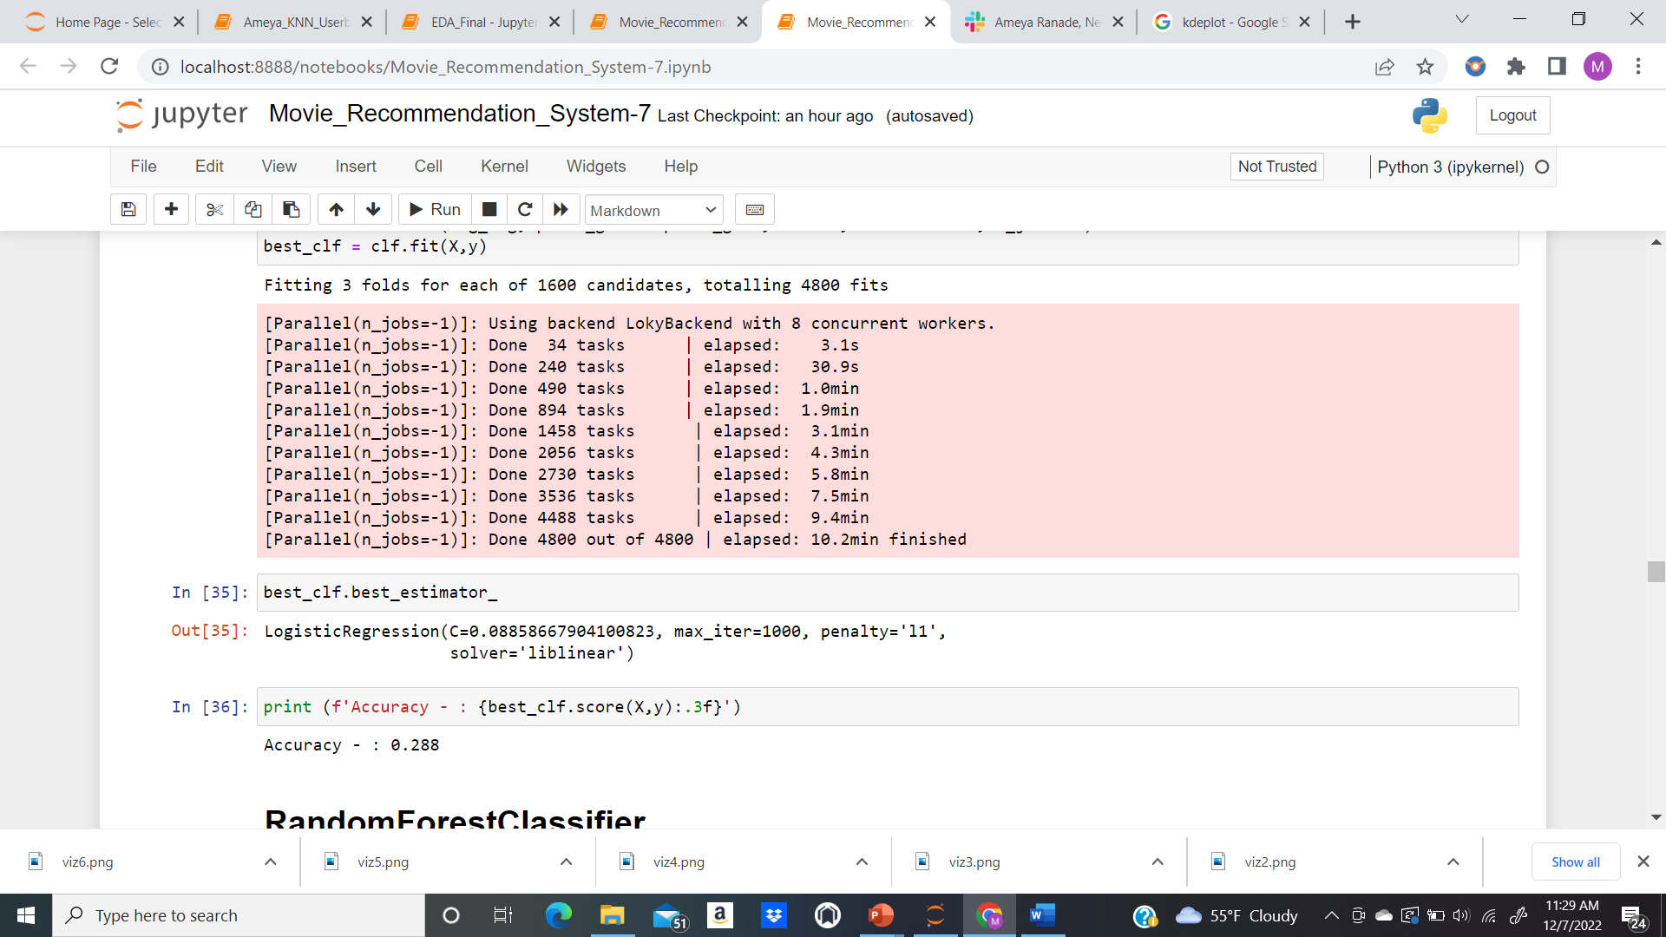
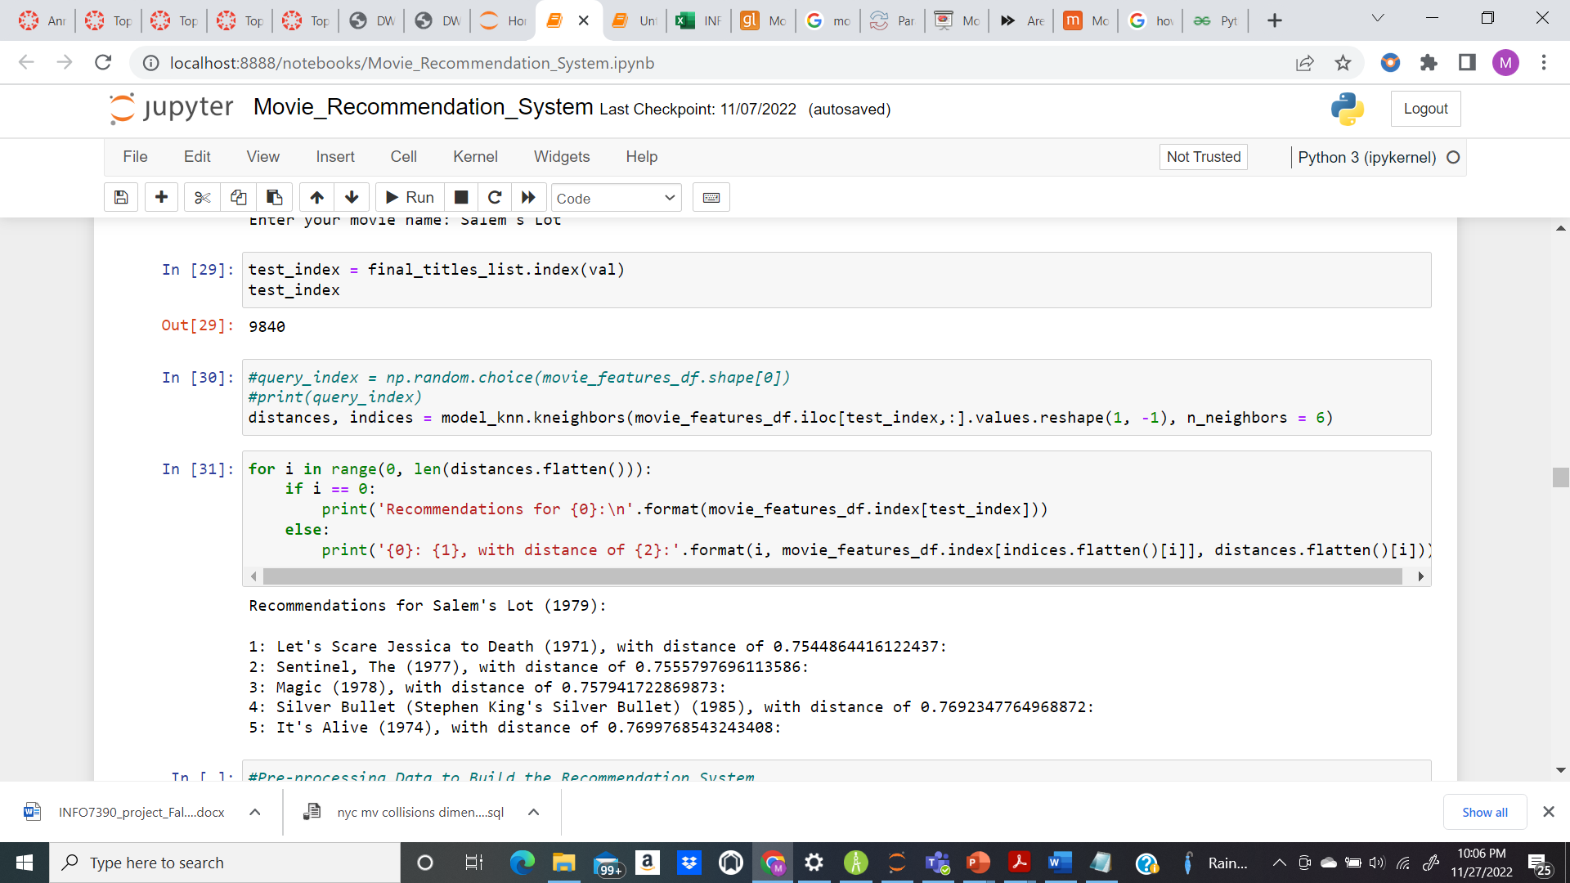
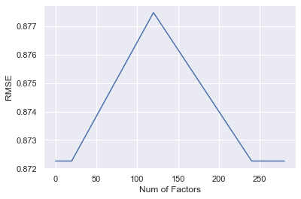
Output
Accuracy- Logistic Regression
Recommended Movies
RMSE- Number of Factors

Slide 8

References
https://grouplens.org/datasets/movielens/25m/
https://www.geeksforgeeks.org/python-implementation-of-movie-recommender-system/

